Slide 1
Graduation Project
website and app for tourists

Slide 2
Main Parts
Website
Mobile application
AI features

Slide 3
Website Parts
UI/UX
Frontend
Backend

Slide 4
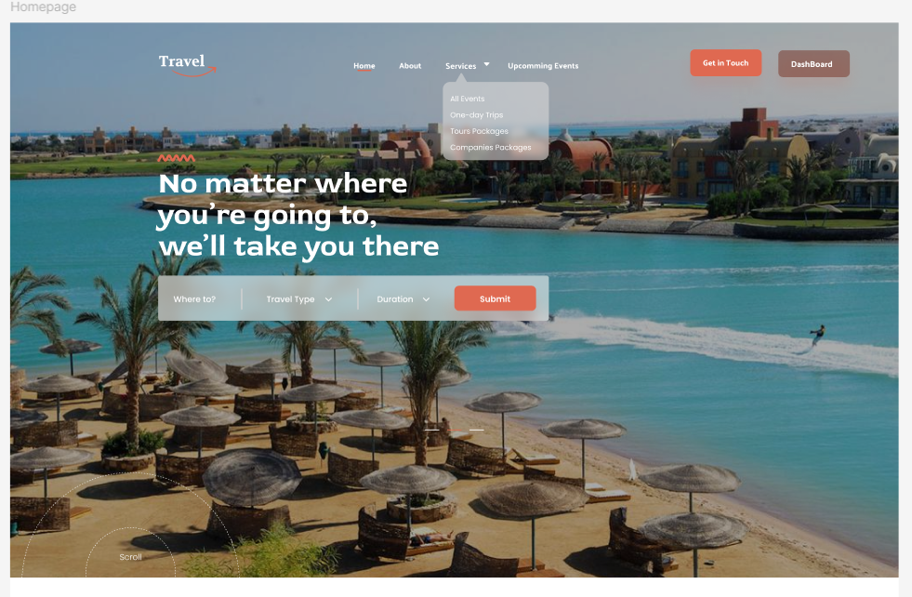
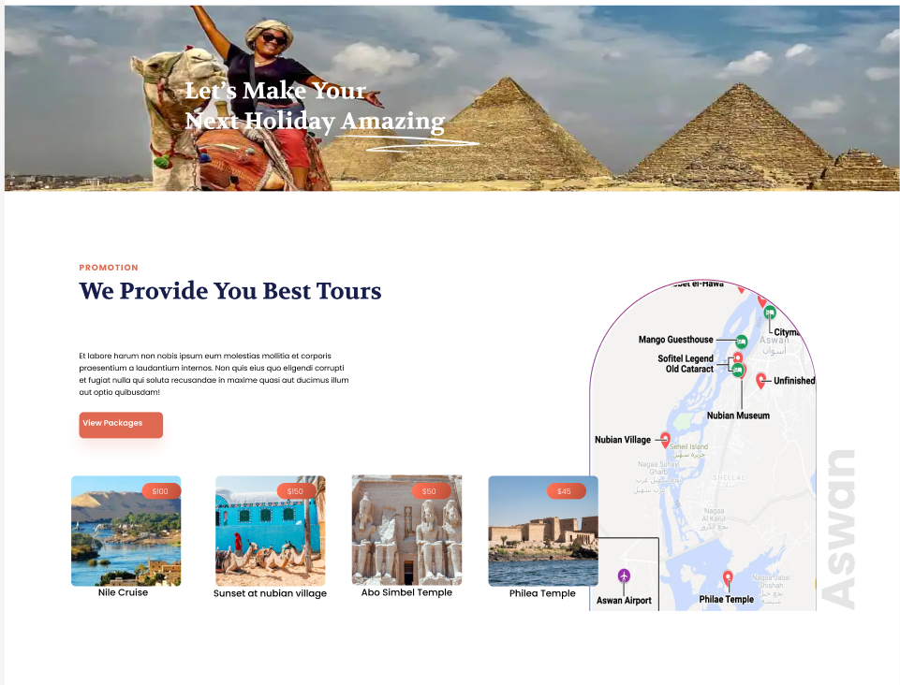
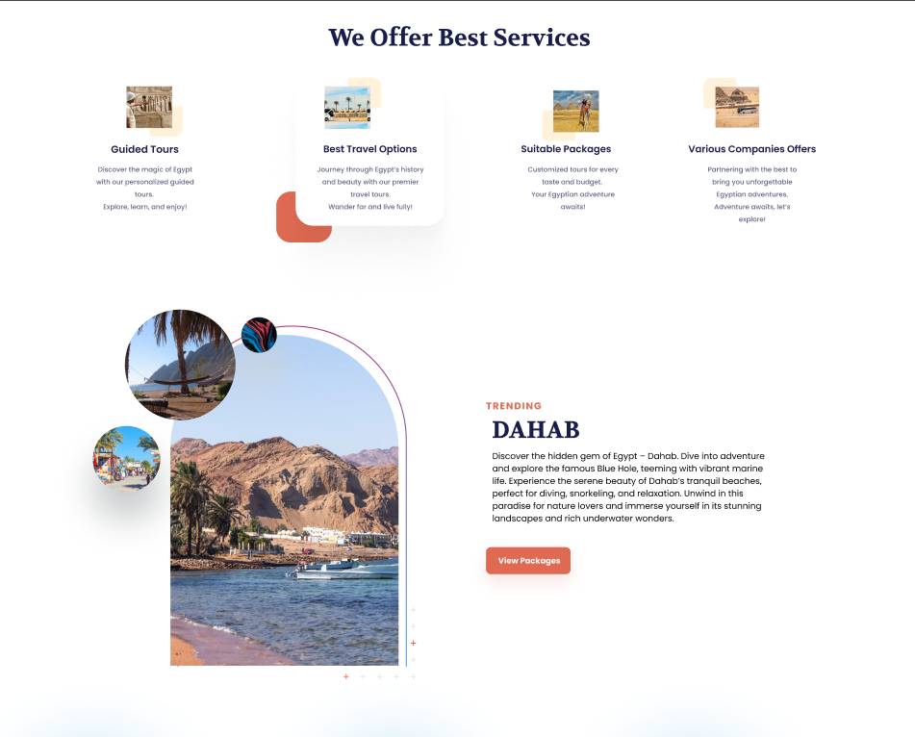
UI/UX
Create an amazing design for our project given the demo of the first page

Slide 5
Frontend Team
We will use React.js to build our frontend pages.
Team collaboration will focus on creating responsive and user-friendly interfaces.
Features include a responsive design, dark and light modes, and animations to enhance the user experience.

Slide 6
Backend Team
We will use .NET API to handle core backend functionalities and data processing.
CRUD operations for efficient management of user data and ticketing details.
Secure payment integration allowing users to book tickets seamlessly.
Multi-language support to make the platform accessible to a global audience.

Slide 7
Mobile application
Cross-Platform Development with Flutter: We will use Flutter to build a responsive mobile app for both Android and iOS devices.
Seamless Integration with Website: The app will be fully synchronized with the website, sharing actions, themes, and user settings to ensure a consistent experience across platforms.

Slide 8
AI features
Data Collection: We will leverage web scraping to gather valuable data from diverse online sources, ensuring a rich dataset for analysis.
AI Model Implementation: Using Large Language Models (LLMs), we will process this data to create intelligent applications, such as interactive chatbots, providing users with real-time assistance and insights.

Slide 9
Project Overview: Smart Travel Platform
Project Overview: We are developing a travel-focused website and mobile application that provides users with an engaging and seamless travel experience.
AI-Powered Homepage: The homepage features AI-driven updates on trending events and popular destinations to keep users informed and inspired.
Comprehensive Travel Options: Users can explore and book travel packages from various providers, with details on destinations, schedules, and pricing.
User-Friendly Booking System: Clients can easily book their desired trips with a secure and straightforward booking process.
24/7 Support Chatbot: An integrated chatbot offers real-time support, answering user questions and assisting with bookings.

